Slide 1


Reporting of GHG inventories under the EU Governance Regulation, adapted to the Energy Community ​
- links to the reporting under Paris Agreement-
© Ani Yordanova, REDISCOVER Nature/EEA
Louise Attard
Bosnia and Herzegovina
October 2025
Notes:
OPENING SLIDE – dark background and white logo

Slide 2

Legal requirements for national GHG inventories and inventory systems
Decision of the Ministerial Council of the Energy Community [D/2021/14/MC_EnC ] adapted from:
Regulation (EU) 2018/1999: Governance of the Energy Union and climate action
Implementing Regulation (EU) 2020/1208: Structure, format and submission process
Delegated Regulation (EU) 2020/1044: GWP, inventory guidelines and Union inventory system
Notes:
1 ) Gov Reg – art 26 which is on annual reporting, art 37 which is energy community and the national inventory systems and the art 38 inventory review.
2. Implementing Regulation (EU) 2020/1208
Focuses on the structure, format, and submission process for GHG inventory reports.
Ensures a standardized approach for:
Data submission from Contracting Parties
Format requirements for reporting GHG emissions and removals.
Facilitates transparency and comparability in GHG inventories across the Energy Community Inventories
3. Delegated Regulation (EU) 2020/1044
Defines the use of Global Warming Potentials (GWP) based on the IPCC guidelines.
Provides inventory guidelines for estimating and reporting GHG emissions.
Establishes the Union Inventory System to harmonize Contracting Parties reports and maintain consistency with international reporting obligations under the Paris Agreement.

Slide 3

GHG inventory reporting under Article 26 of the EU Governance Regulation and links to the Paris Agreement
Consistency with international reporting requirements under the Paris Agreement
Same GHG inventory guidelines
Same IPCC global warming potentials (AR5)
Same methodological guidance to estimate emissions and removals
The Delegated Act to the Governance Regulation is explicit in articles 2 and 3
Notes:
This article highlights the consistency between EU GHG reporting and international reporting.
Consistency with the IPCC GHG Inventory Guidelines and GWP (AR5)
Methodological Guidance – this aligns with the methodologies prescribed by the IPCC for estimating GHG emissions and removals
The Delegated Act to the Gov Reg – Art 2 provide guidelines for the GHG Inventories and Art 3 Expands on the methodological and reporting requirements

Slide 4

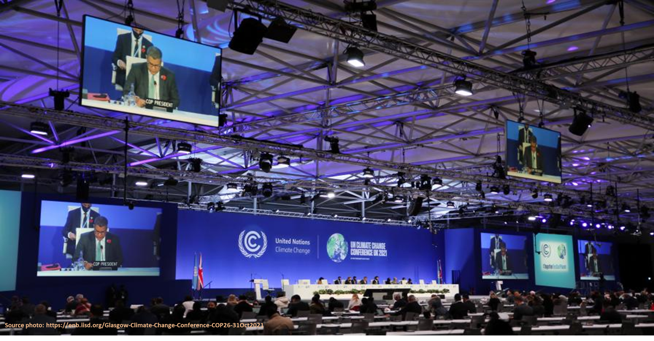





GHG inventory reporting: main documents and tools to be aware of, and to be use (Gov.Reg & Paris Agreement)
What to report: Decision 18/CMA.1 (MPGs, Katowice)
How to report:
Common reporting tables (CRTs) & UNFCCC reporting tool - 5/CMA.3
National inventory document (NID) - 5/CMA.3
How to estimate emissions and removals: IPCC 2006 Guidelines and its 2019 refinement – 5/CMA.3
Notes:
Decision 18/CMA.1 – deals with modalities, procedures and guidelines for the transparency framework for action. Supports the Paris Agreement.

Slide 5

Timelines for reporting under the EU Governance Regulation and the Paris Agreement
EU Governance submission deadlines: 15/01 (draft inventories) 15/03 (final inventories) 31/07 (Approximated Greenhouse Gas Inventories)
EEA carries out QA/QC initial checks on draft inventory submissions between 15/01 and 28/02
Frequency Energy Community: Annual (Biennial under the PA)
MPGs:

Slide 6
Timeline as regards GHG inventories
15 Jan Draft submission GHG Inventories
X-2
15 March Final submission GHG Inventories
X-2
31 July Approximated GHG Inventories
X-1
Notes:
Every year by 15th January from 2025 submission of Preliminary estimates of the GHG Inventories (tables and short descriptions)
Every year, by 15th March 2025, CPs submit the final greenhouse gas inventory and up-to-date national inventory report.

Slide 7
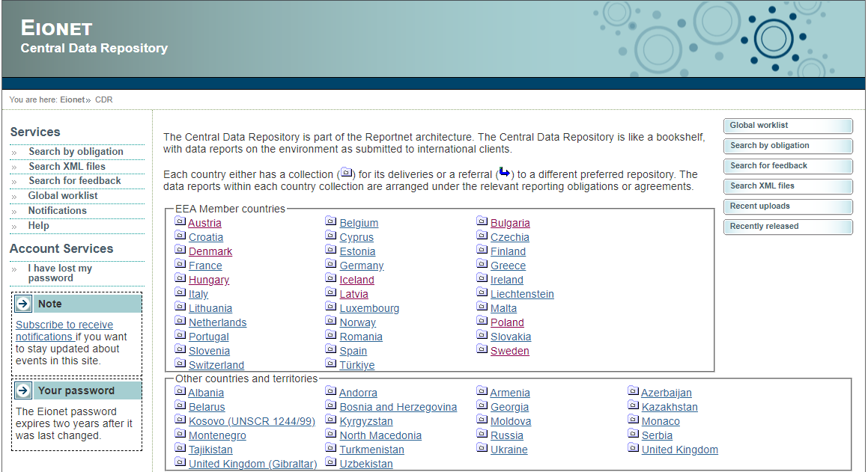
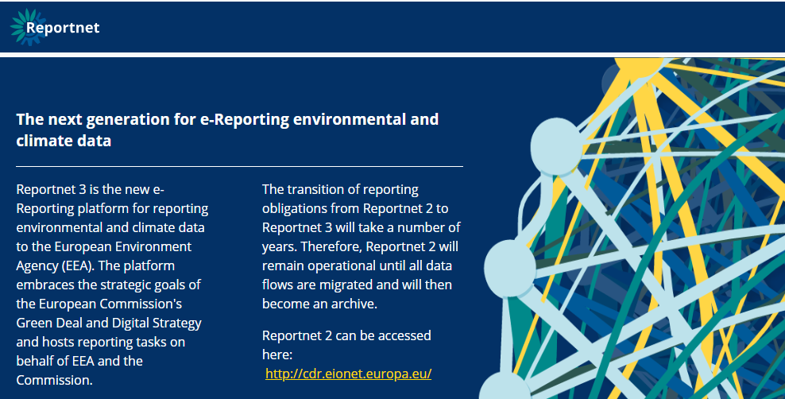
Reporting Platforms
GHG inventories - Reportnet2
Link: CDR (europa.eu)
Approximated GHG inventories - Reportnet3
Link: Reportnet 3 (europa.eu)
Notes:
For Repotnet2: eionet login is required. The National Focal Point (NFP) can coordinate and assist
For Reportnet3: Lead Reporter will have the rights to assign other reporters

Slide 8
Additional reporting: GHG inventory Annexes (Implementing Regulation)
Annexes facilitate the QA/QC of submissions to the EU and the preparation of the Energy Community inventory
Types of submission: separate, part of NID
Templates of Annexes will be provided by EEA
reasons for recalculations (art.9)
implementation of review recommendations (art.10)
methodological descriptions (art.11)
uncertainty analysis (art.12.1)
assessment of completeness (art.12.2)
reporting on indicators (art.13)
consistency with ‘EC information’ (art.14 on EU ETS, adapted)
consistency with air pollutants (art.15 deleted)
consistency with fluorinated gases (art.16)
consistency with energy statistics (art.17)
changes to national systems and registries (art.18)

Slide 9
National inventory systems (NIS) under article 37 of the Adapted EU Governance Regulation
Broadly consistent with MPGs but focus on establishment and not reporting
By 1/1/2023, establish, operate and continuously improve NIS to estimate emissions and removals to ensure the TACCC of the GHG inventory
Ensure that the national competent inventory authorities have access to the necessary information to prepare and report the GHG inventory
Ensure sufficient capacity for the timely performance of GHG inventory functions, including data collection and the technical competence of staff involved
Notes:
By 1 Jan 2023 countries should have established the National Inventory System - purpose is to ensure that GHG inventories meet the TACCC principles (Transparency, Accuracy, Consistency, Comparability, and Completeness).
The relevant national authorities must have access to the necessary data and information to 1) prepare the ghg Inventory and 2) to ensure accurate reporting of the GHG emissions.
NIS

Slide 10
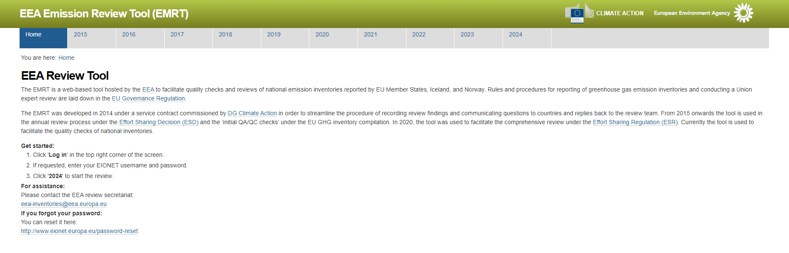
EMISSION REVIEW TOOL (EMRT) for GHG inventories
Notes:
The EEA, with its ETC are responsible for the implementation of QA/QC checks for the Energy Community inventory
The communication and exchange of information, among CPs and EEA is done via an online platform.

Slide 11
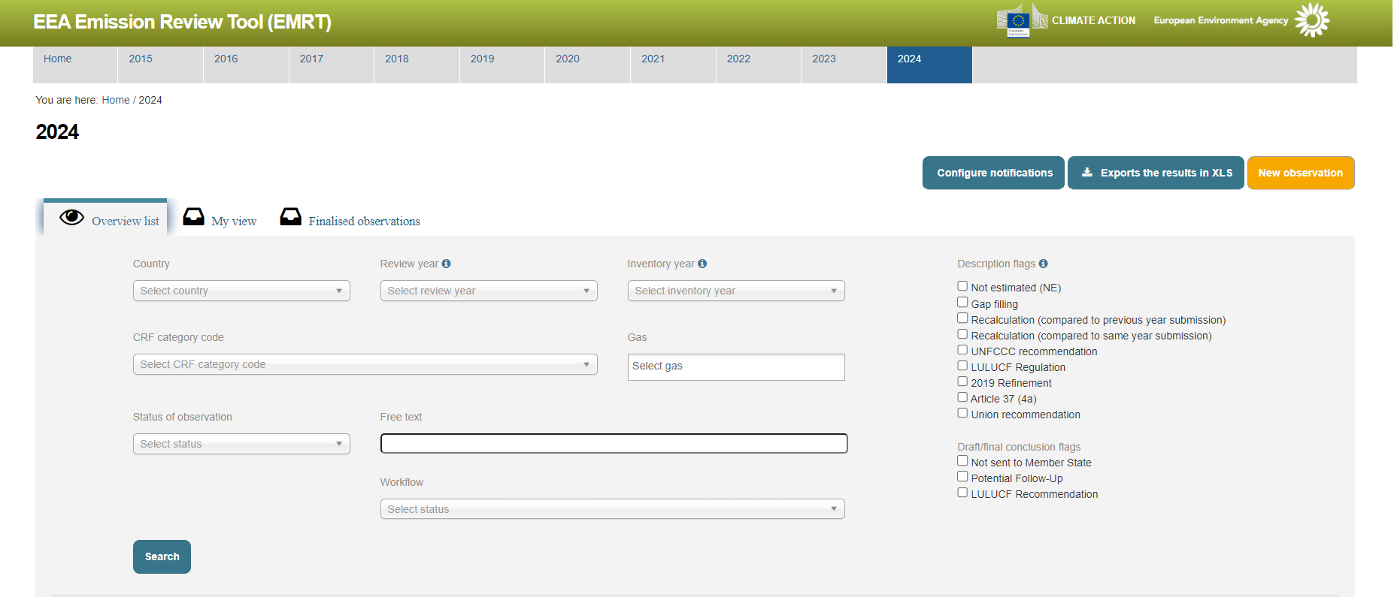
EMISSIONS REVIEW TOOL (EMRT) for GHG inventories

Slide 12
Timeline for QA/QC of the GHGI submissions by the CPs under the Energy Community
QAQC from 15/01 to 27/2
CPs
15 January submissions
EEA
By 28/02
CPs
Observations uploaded into the EMRT
EEA
CPs
From 28/02 to 15/03
Responses to observations into the EMRT
EEA
CPs
From 15/03 to 28/03
EEA
EEA follows up on CPs' responses
From 30/03 to 07/04
CPs
Responses to follow up observations
EEA
Final conclusions by 20/04
Resolved
Partially
Resolved
Unresolved

Slide 13
EEA support towards the Energy Community Contracting Parties with the Implementation of the reporting requirements of the regulation 2018/1999 The Energy Union Governance Regulation.
GHG Inventory Component Part 1 – Started in Oct 2024- end of September 2025
GHG Inventory Component Part 2 – 1st October – end of December 2025
Notes:
For the Component Part 1 – Citepa supported in doing training and capacity buildings in webinars, trainings in-country visits and remote support to the Contracting Parties. Example : supporting CPs in filling up the Annexes, in Crt tables and also supporting in compiling the NID.
For Part 2 – we will continue the support. We sent out the questionnaire and requested some experience in compiling the Inventory, what challenges they are finding and what support they think they will need. We also had email requests from CP in specific sectors.

Slide 14

Thank you!
Louise.Attard@eea.europa.eu
European Environment Agency
© Dominika Hrašková, REDISCOVER Nature/EEA

